Slide 1
0
9
Cellular Respiration and Fermentation

Slide 2
Life Is Work
Living cells require energy from outside sources
Some animals, such as the giraffe, obtain energy by eating plants, and some animals feed on other organisms that eat plants

Slide 3
Energy flows into an ecosystem as sunlight and leaves as heat
Photosynthesis generates O₂ and organic molecules, which are used in cellular respiration
Cells use chemical energy stored in organic molecules to generate ATP, which powers work

Slide 4
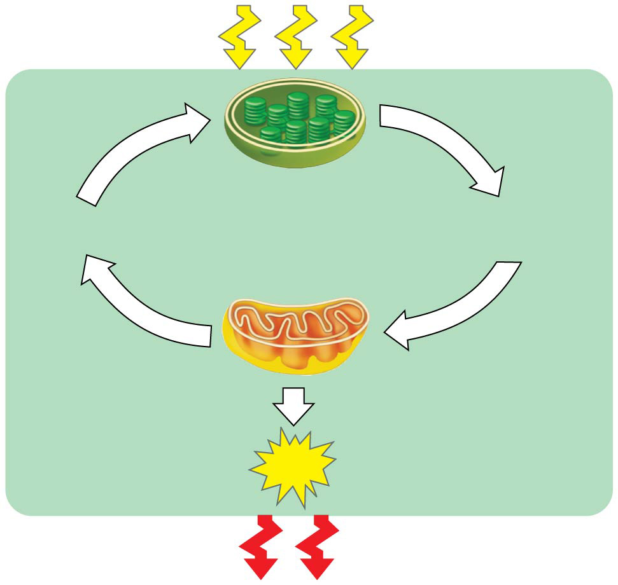
Figure 9.2
Light
energy
ECOSYSTEM
Photosynthesis
in chloroplasts
CO₂
+
H₂O
Organic
molecules
O₂
+
Cellular respiration
in mitochondria
ATP powers
most cellular work
ATP
Heat
energy
Notes:
Figure 9.2 Energy flow and chemical recycling in ecosystems

Slide 5
Catabolic Pathways and Production of ATP
Fermentation is a partial degradation of sugars that occurs without O₂
Aerobic respiration consumes organic molecules and O₂ and yields ATP
Anaerobic respiration is similar to aerobic respiration but consumes compounds other than O₂ e.g sulphate

Slide 6
Cellular respiration includes both aerobic and anaerobic respiration but is often used to refer to aerobic respiration
Although carbohydrates, fats, and proteins are all consumed as fuel, it is helpful to trace cellular respiration with the sugar glucose
C₆H₁₂O₆ + 6 O₂ → 6 CO₂ + 6 H₂O + Energy (ATP + heat)

Slide 7
Redox Reactions: Oxidation and Reduction
The transfer of electrons during chemical reactions releases energy stored in organic molecules
This released energy is ultimately used to synthesize ATP

Slide 8
The Principle of Redox
Chemical reactions that transfer electrons between reactants are called oxidation-reduction reactions, or redox reactions
In oxidation, a substance loses electrons, or is oxidized
In reduction, a substance gains electrons, or is reduced (the amount of positive charge is reduced)

Slide 9
Figure 9.UN01
becomes oxidized
(loses electron)
becomes reduced
(gains electron)
Notes:
Figure 9.UN01 In-text figure, NaCl redox reaction, p. 164

Slide 10
Figure 9.UN02
The electron donor is called the reducing agent
The electron receptor is called the oxidizing agent
becomes oxidized
becomes reduced
Notes:
Figure 9.UN02 In-text figure, generalized redox reaction, p. 164

Slide 11
Oxidation of Organic Fuel Molecules During Cellular Respiration
During cellular respiration, the fuel (such as glucose) is oxidized, and O₂ is reduced
becomes oxidized
becomes reduced

Slide 12
The Stages of Cellular Respiration: A Preview
Harvesting of energy from glucose has three stages
Glycolysis (breaks down glucose into two molecules of pyruvate) occurs in cytoplasm
The citric acid cycle (completes the breakdown of glucose)occurs in mitochondria
Oxidative phosphorylation (accounts for most of the ATP synthesis) occurs in mitochondria
Accounts for almost 90% of the ATP generated

Slide 13
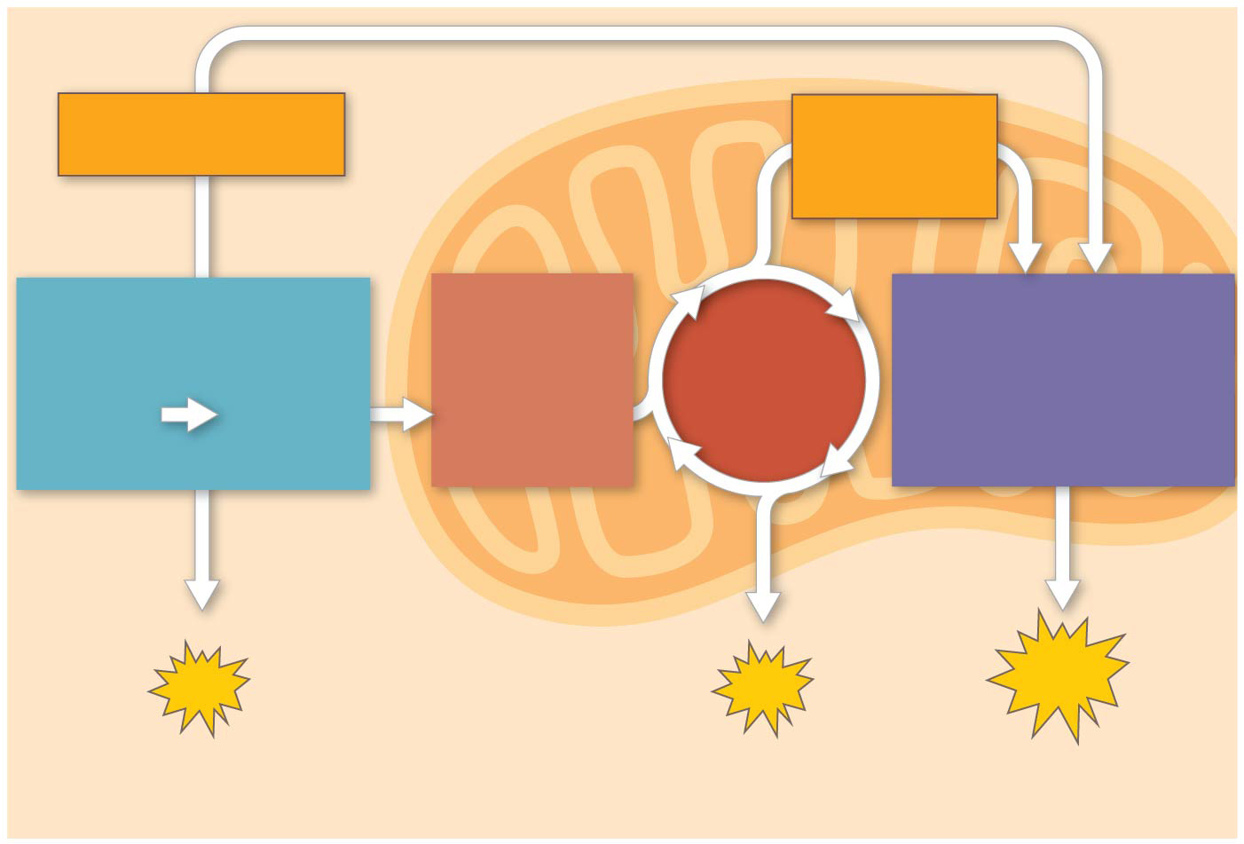
Figure 9.6-3
Electrons
via NADH
Electrons
via NADH
and FADH₂
GLYCOLYSIS
PYRUVATE
OXIDATION
OXIDATIVE
PHOSPHORYLATION
CITRIC
ACID
CYCLE
Glucose
Pyruvate
Acetyl CoA
(Electron transport
and chemiosmosis)
CYTOSOL
MITOCHONDRION
ATP
ATP
ATP
Substrate-level
Substrate-level
Oxidative
Notes:
Figure 9.6-3 An overview of cellular respiration (step 3)

Slide 14
A smaller amount of ATP is formed in glycolysis and the citric acid cycle by substrate-level phosphorylation
For each molecule of glucose degraded to CO₂ and water by respiration, the cell makes up to 32 molecules of ATP

Slide 15
Concept 9.2: Glycolysis harvests chemical energy by oxidizing glucose to pyruvate
Glycolysis (“sugar splitting”) breaks down glucose into two molecules of pyruvate
Glycolysis occurs in the cytoplasm
Glycolysis occurs whether or not O₂ is present
In the presence of O₂, pyruvate enters the mitochondrion (in eukaryotic cells) where the oxidation of glucose is completed

Slide 16
Oxidation of Pyruvate to Acetyl CoA
Before the citric acid cycle can begin, pyruvate must be converted to acetyl Coenzyme A (acetyl CoA), which links glycolysis to the citric acid cycle
The citric acid cycle, also called the Krebs cycle, completes the break down of pyruvate to CO₂

Slide 17
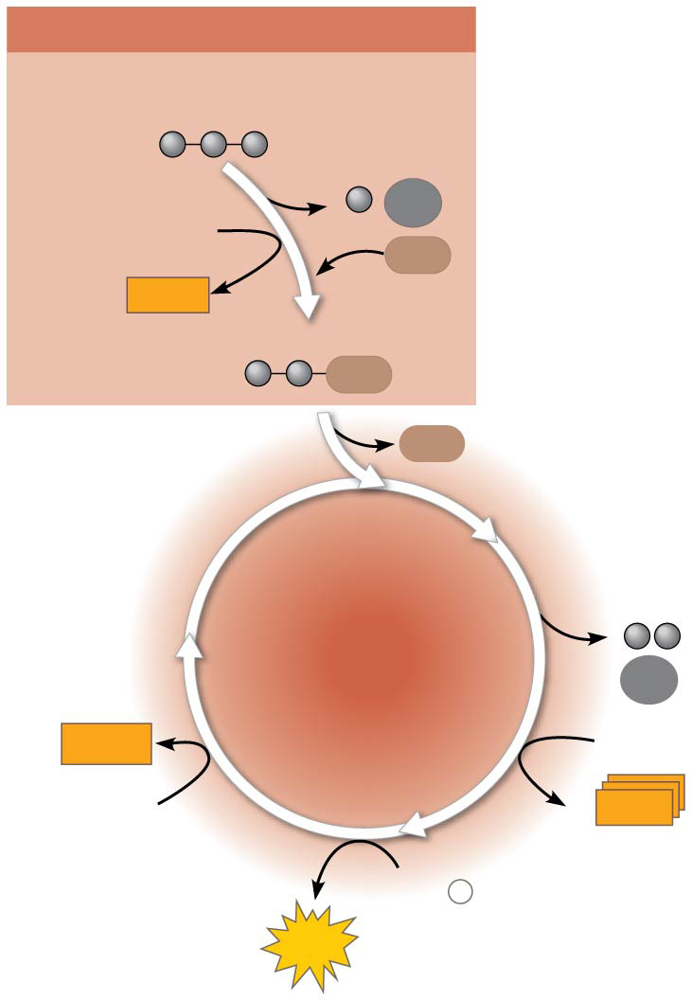
Figure 9.11
PYRUVATE OXIDATION
Pyruvate (from glycolysis,
2 molecules per glucose)
The citric acid cycle has eight steps, each catalyzed by a specific enzyme
CO₂
NAD⁺
CoA
NADH
+ H⁺
Acetyl CoA
CoA
CoA
CITRIC
ACID
CYCLE
CO₂
2
FADH₂
3
NAD⁺
FAD
CoA
3
NADH
+
3 H⁺
ADP
+
P
i
ATP
Notes:
Figure 9.11 An overview of pyruvate oxidation and the citric acid cycle

Slide 18
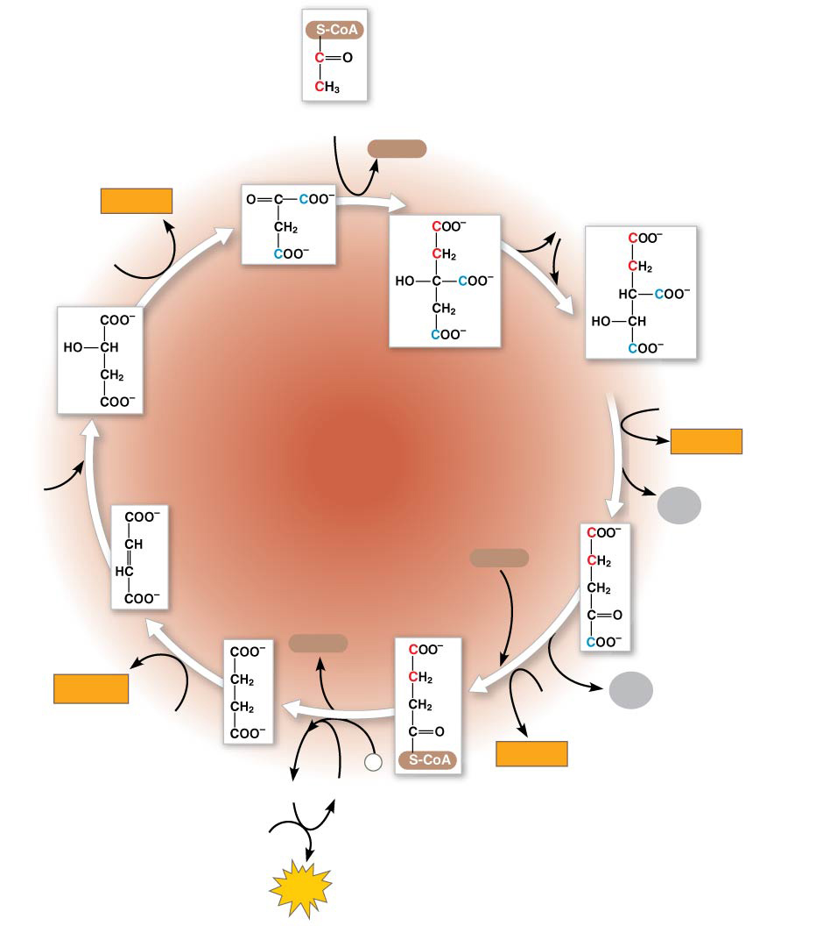
Figure 9.12-8
Acetyl CoA
CoA-SH
NADH
H₂O
+ H⁺
1
NAD⁺
Oxaloacetate
8
2
Malate
Citrate
Isocitrate
CITRIC
ACID
CYCLE
NAD⁺
3
NADH
7
+ H⁺
H₂O
CO₂
Fumarate
CoA-SH
α-Ketoglutarate
6
4
CoA-SH
FADH₂
5
NAD⁺
CO₂
FAD
Succinate
P
NADH
GTP
GDP
i
+ H⁺
Succinyl
CoA
ADP
ATP
Notes:
Figure 9.12-8 A closer look at the citric acid cycle (step 8)

Slide 19
Concept 9.4: During oxidative phosphorylation, chemiosmosis couples electron transport to ATP synthesis
Following glycolysis and the citric acid cycle, NADH(Nicotinamide adenine dinucleotide) and FADH₂ (Flavin adenine dinucleotide) account for most of the energy extracted from food
These two electron carriers donate electrons to the electron transport chain, which powers ATP synthesis via oxidative phosphorylation

Slide 20
The Pathway of Electron Transport
The electron transport chain is in the inner membrane (cristae) of the mitochondrion
Most of the chain’s components are proteins, which exist in multiprotein complexes

Slide 21
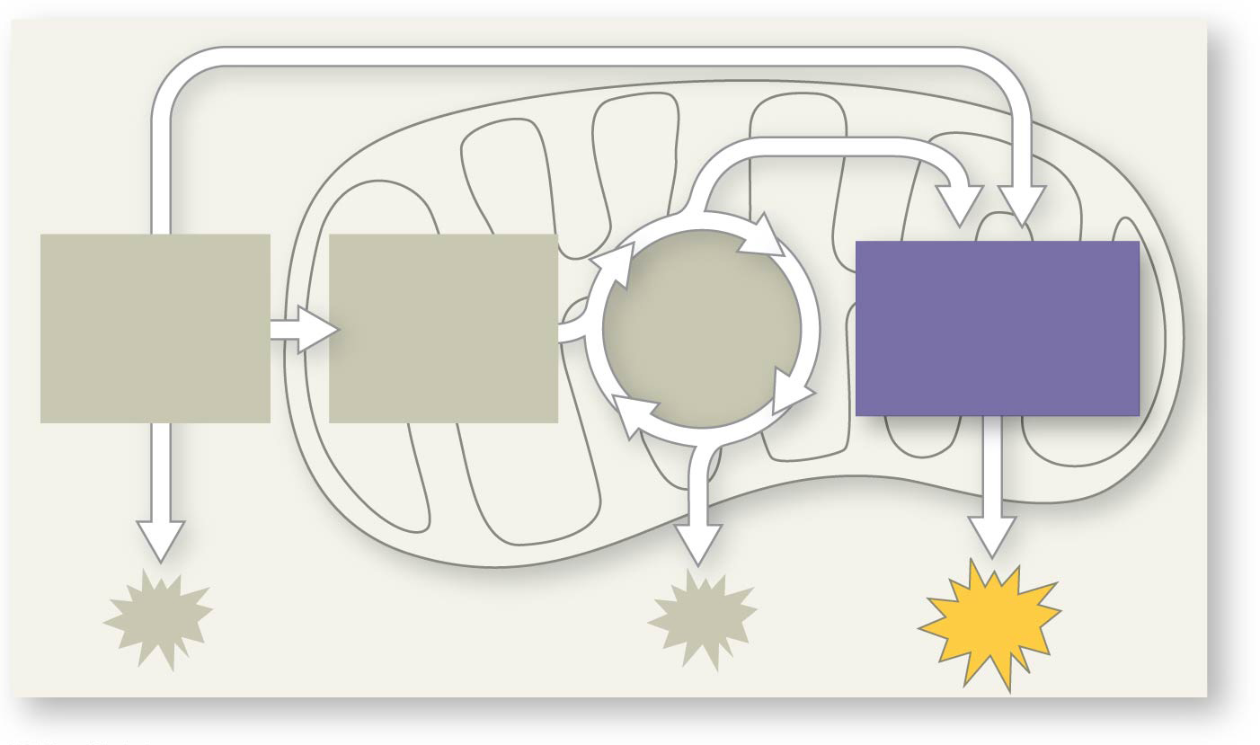
Figure 9.UN09
PYRUVATE
OXIDATION
CITRIC
ACID
CYCLE
OXIDATIVE
PHOSPHORYL-
ATION
GLYCOLYSIS
ATP
Notes:
Figure 9.UN09 In-text figure, mini-map, oxidative phosphorylation, p. 172

Slide 22
An Accounting of ATP Production by Cellular Respiration
During cellular respiration, most energy flows in this sequence:
glucose → NADH → electron transport chain → proton-motive force → ATP
About 34% of the energy in a glucose molecule is transferred to ATP during cellular respiration, making about 32 ATP
There are several reasons why the number of ATP is not known exactly

Slide 23
Concept 9.5: Fermentation and anaerobic respiration enable cells to produce ATP without the use of oxygen
Most cellular respiration requires O₂ to produce ATP
Without O₂, the electron transport chain will cease to operate
In that case, glycolysis couples with anaerobic respiration or fermentation to produce ATP

Slide 24
Anaerobic respiration uses an electron transport chain with a final electron acceptor other than O₂, for example sulfate
Fermentation uses substrate-level phosphorylation instead of an electron transport chain to generate ATP

Slide 25
Types of Fermentation
Fermentation consists of glycolysis plus reactions that regenerate NAD⁺, which can be reused by glycolysis
Two common types are alcohol fermentation and lactic acid fermentation

Slide 26
In alcohol fermentation, pyruvate is converted to ethanol in two steps
The first step releases CO₂
The second step produces ethanol
Alcohol fermentation by yeast is used in brewing, winemaking, and baking

Slide 27
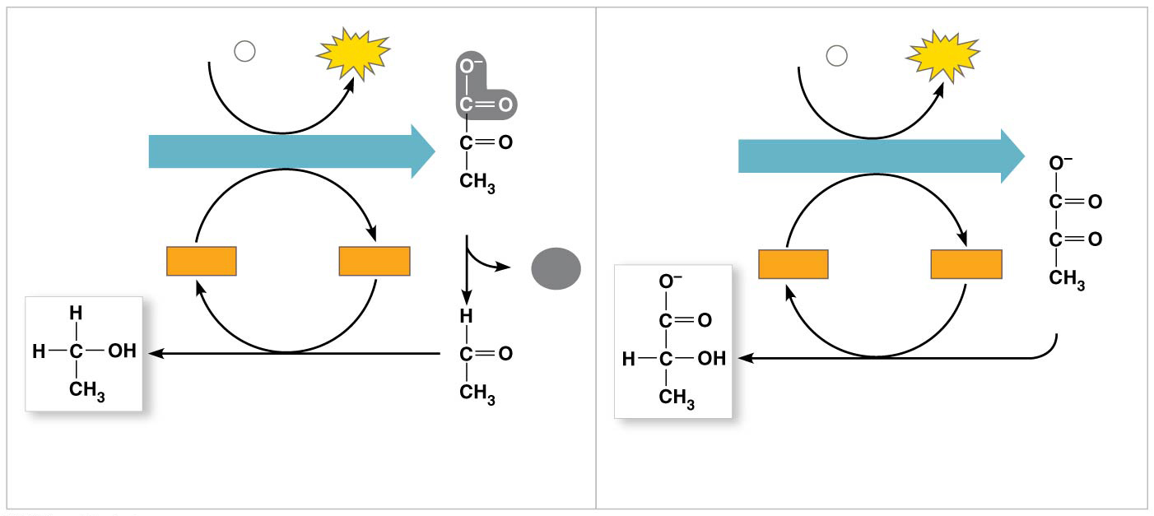
Figure 9.17
2 ADP + 2
P
2
ATP
2 ADP + 2
2
ATP
i
P
i
Glucose
GLYCOLYSIS
Glucose
GLYCOLYSIS
2 Pyruvate
2
NAD⁺
2
NADH
CO₂
2
NAD⁺
2
NADH
2
+ 2 H⁺
+ 2 H⁺
2
Pyruvate
2 Ethanol
2 Acetaldehyde
2 Lactate
(a)
Alcohol fermentation
(b)
Lactic acid fermentation
Notes:
Figure 9.17 Fermentation

Slide 28
Animation: Fermentation Overview

Slide 29
In lactic acid fermentation, pyruvate is reduced by NADH, forming lactate as an end product, with no release of CO₂
Lactic acid fermentation by some fungi and bacteria is used to make cheese and yogurt
Human muscle cells use lactic acid fermentation to generate ATP when O₂ is scarce

Slide 30
Comparing Fermentation with Anaerobic and Aerobic Respiration
All use glycolysis (net ATP = 2) to oxidize glucose and harvest chemical energy of food
In all three, NAD⁺ is the oxidizing agent that accepts electrons during glycolysis

Slide 31
The processes have different mechanisms for oxidizing NADH:
In fermentation, an organic molecule (such as pyruvate or acetaldehyde) acts as a final electron acceptor
In cellular respiration electrons are transferred to the electron transport chain
Cellular respiration produces 32 ATP per glucose molecule; fermentation produces 2 ATP per glucose molecule

Slide 32
Obligate anaerobes carry out fermentation or anaerobic respiration and cannot survive in the presence of O₂
Yeast and many bacteria are facultative anaerobes, meaning that they can survive using either fermentation or cellular respiration
In a facultative anaerobe, pyruvate is a fork in the metabolic road that leads to two alternative catabolic routes

Slide 33
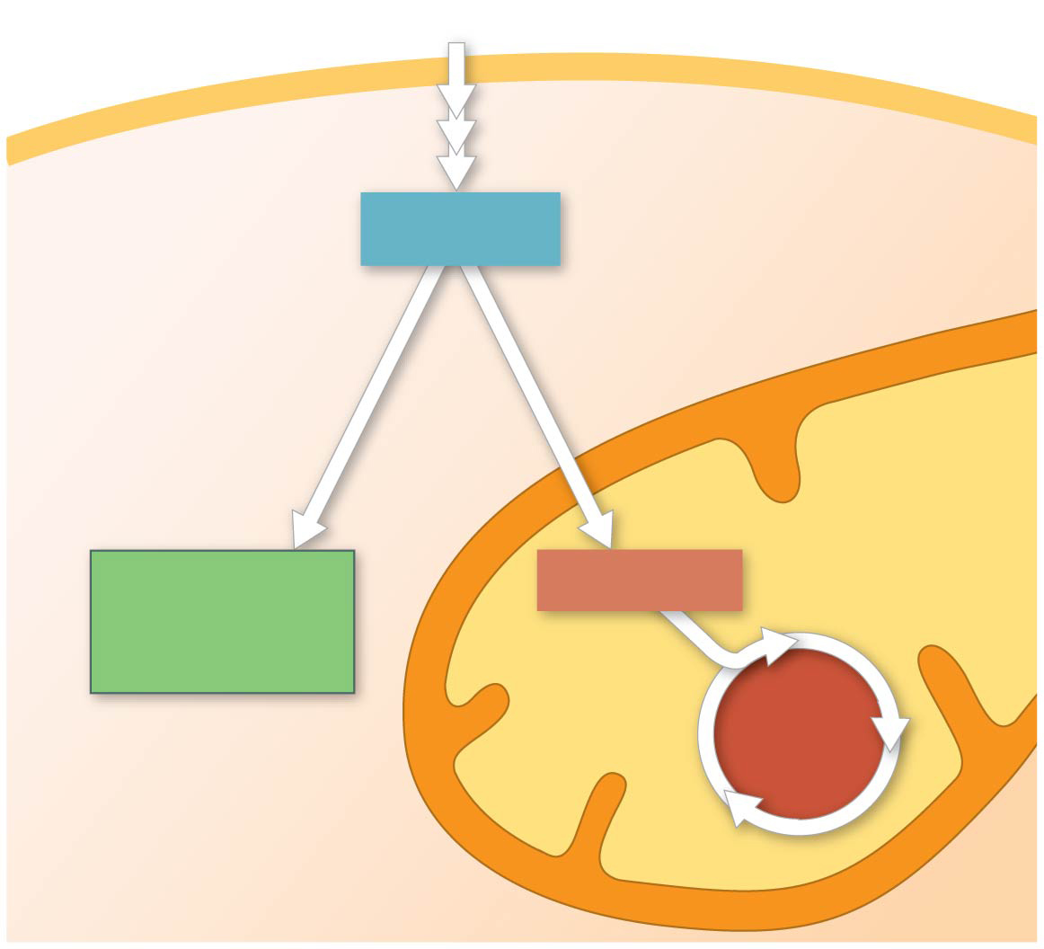
Figure 9.18
Glucose
Glycolysis
CYTOSOL
Pyruvate
No O₂ present:
Fermentation
O₂ present:
Aerobic cellular
respiration
MITOCHONDRION
Ethanol,
lactate, or
other products
Acetyl CoA
CITRIC
ACID
CYCLE
Notes:
Figure 9.18 Pyruvate as a key juncture in catabolism

Slide 34
The Evolutionary Significance of Glycolysis
Ancient prokaryotes are thought to have used glycolysis long before there was oxygen in the atmosphere
Very little O₂ was available in the atmosphere until about 2.7 billion years ago, so early prokaryotes likely used only glycolysis to generate ATP
Glycolysis is a very ancient process

Slide 35
The Versatility of Catabolism
Catabolic pathways funnel electrons from many kinds of organic molecules into cellular respiration
Glycolysis accepts a wide range of carbohydrates
Proteins must be digested to amino acids; amino groups can feed glycolysis or the citric acid cycle

Slide 36
Fats are digested to glycerol (used in glycolysis) and fatty acids (used in generating acetyl CoA)
Fatty acids are broken down by beta oxidation and yield acetyl CoA
An oxidized gram of fat produces more than twice as much ATP as an oxidized gram of carbohydrate

Slide 37
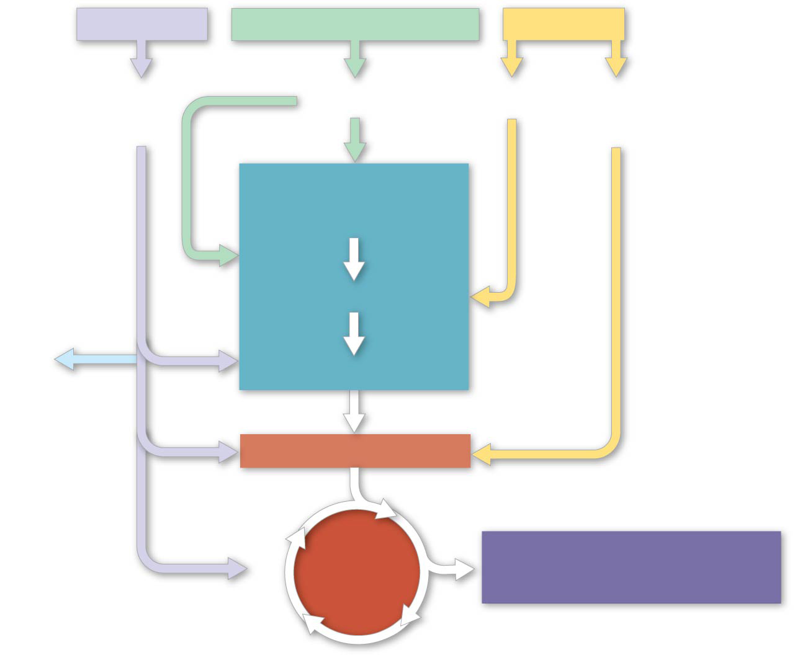
Figure 9.19-5
Proteins
Carbohydrates
Fats
Amino
acids
Sugars
Glycerol
Fatty
acids
GLYCOLYSIS
Glucose
Glyceraldehyde 3-
P
NH₃
Pyruvate
Acetyl CoA
CITRIC
ACID
CYCLE
OXIDATIVE
PHOSPHORYLATION
Notes:
Figure 9.19-5 The catabolism of various molecules from food (step 5)

Slide 38
Biosynthesis (Anabolic Pathways)
The body uses small molecules to build other substances
These small molecules may come directly from food, from glycolysis, or from the citric acid cycle

Slide 39
Regulation of Cellular Respiration via Feedback Mechanisms
Feedback inhibition is the most common mechanism for metabolic control
If ATP concentration begins to drop, respiration speeds up; when there is plenty of ATP, respiration slows down

Slide 40
Figure 9.UN11
Inputs
Outputs
GLYCOLYSIS
Glucose
2 Pyruvate
+
2
ATP
+
2
NADH
Notes:
Figure 9.UN11 Summary of key concepts: glycolysis

Slide 41
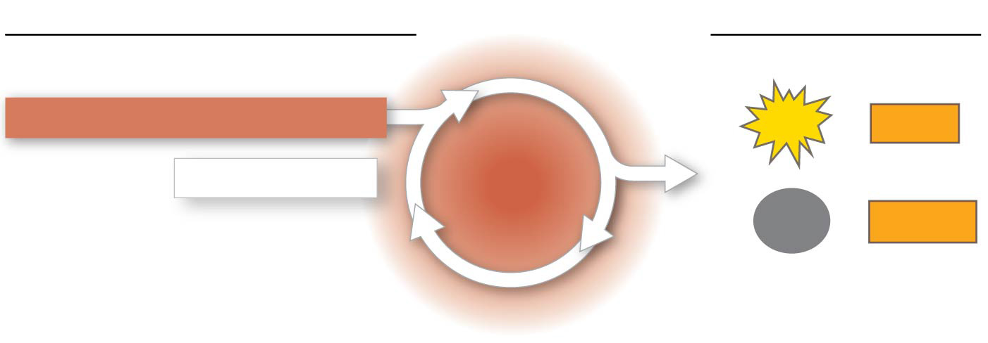
Figure 9.UN12
Inputs
Outputs
2 Pyruvate
2 Acetyl CoA
2
ATP
8
NADH
CITRIC
ACID
CYCLE
2 Oxaloacetate
6
CO₂
2
FADH₂
Notes:
Figure 9.UN12 Summary of key concepts: citric acid cycle

Slide 42
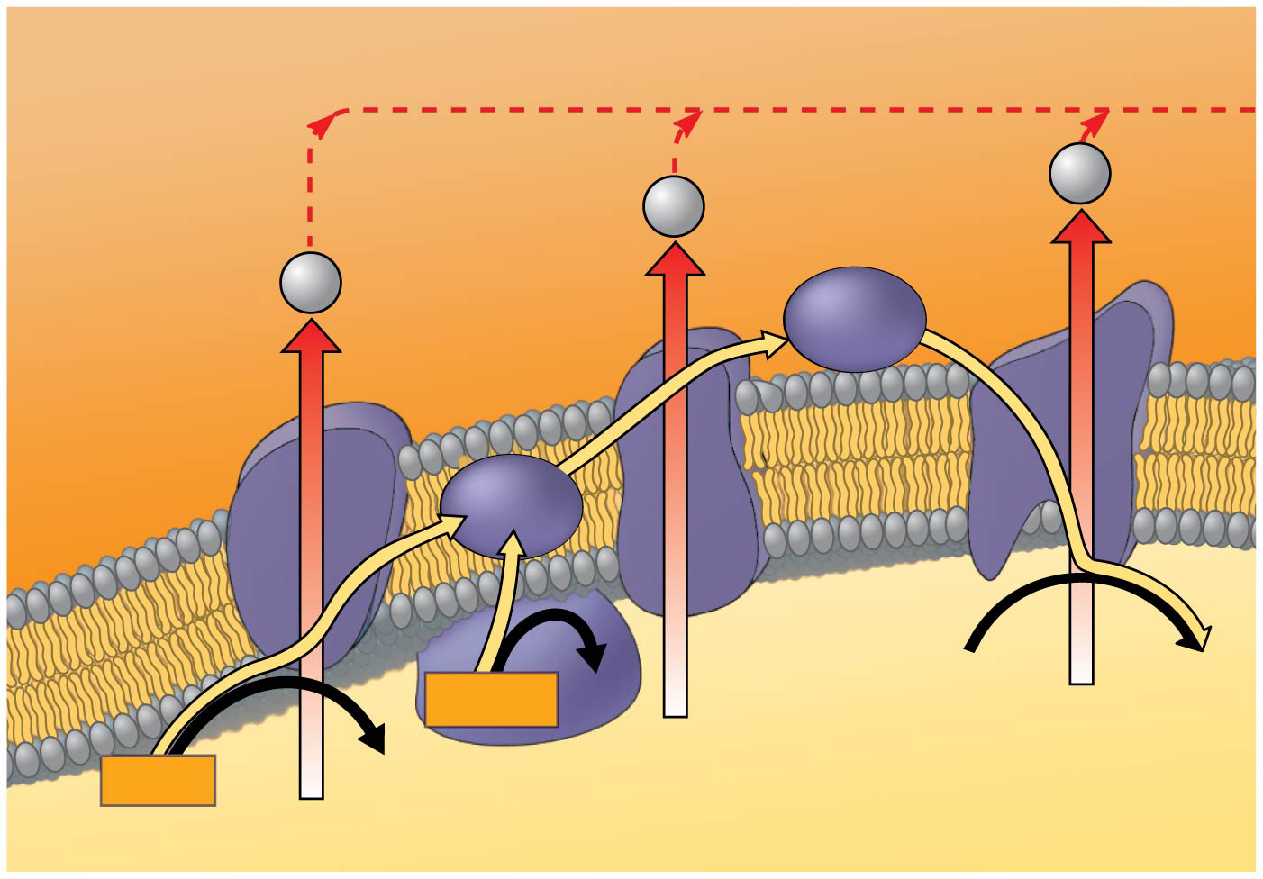
Figure 9.UN13
INTERMEMBRANE
SPACE
H⁺
H⁺
H⁺
Cyt c
Protein complex
of electron
carriers
IV
Q
I
III
II
FAD
2 H⁺ + ½ O₂
H₂O
FADH₂
NADH
NAD⁺
MITOCHONDRIAL MATRIX
(carrying electrons from food)
Notes:
Figure 9.UN13 Summary of key concepts: electron transport chain

Slide 43
